Slide 1
Career induction programmes in Europe: a comparative analysis and case study of the guidance counsellor in Spain
Dra. Rosa Eva Valle and Margarita Cosmen
Faculty of Education
University of León. Spain.

Slide 2
Index
Theoretical framework: Career induction programmes in Europe
Aims and Method our research
Main problems of the teaching function in Europe.
Professional induction programs (PIP) in Europe
Research results on the problems of novice-beginning teachers.
Case Study: Educational and Psychopedagogical Guidance and Counseling Team
Contextualisation
Results of the SWOT analysis.
Conclusions and Proposals for improvement

Slide 3
I. Theoretical framework: Career induction programmes in Europe
Teacher training represents a fundamental pillar for an inclusive, effective, and quality education according Sustainable Development Goals (SDGs) and the European Agenda 2030.
European Model promotes the acquisition of skills such as curricular planning focused on learning situations, the design of pedagogical strategies with the diversity of students in mind, formative and summative assessment, the effective use of educational technologies, and continuous reflection on their own practice for the development and constant improvement of their professional practice.

Slide 4
II. Aims and Method
Aims
Analyze the main difficulties faced by new teachers by reviewing research on the subject and reports issued by national and European agencies.
Carry out a summary of the characteristics of induction programmes offered by European countries in terms of their objectives, duration, and activities.
Carry out a SWOT analysis by means of a case study referring to the professional immersion phase of educational counsellors in the Community of Castilla y León (Spain).
Method
Different techniques of qualitative methodology, comparative documentary analysis and biographical-narrative techniques are used. The documentary analysis is carried out on the reports issued by the Euridyce network and the review of research on mentoring programmes in the teacher induction phase
The case study is carried out by means of an in-depth biographical interview with a key informant

Slide 5
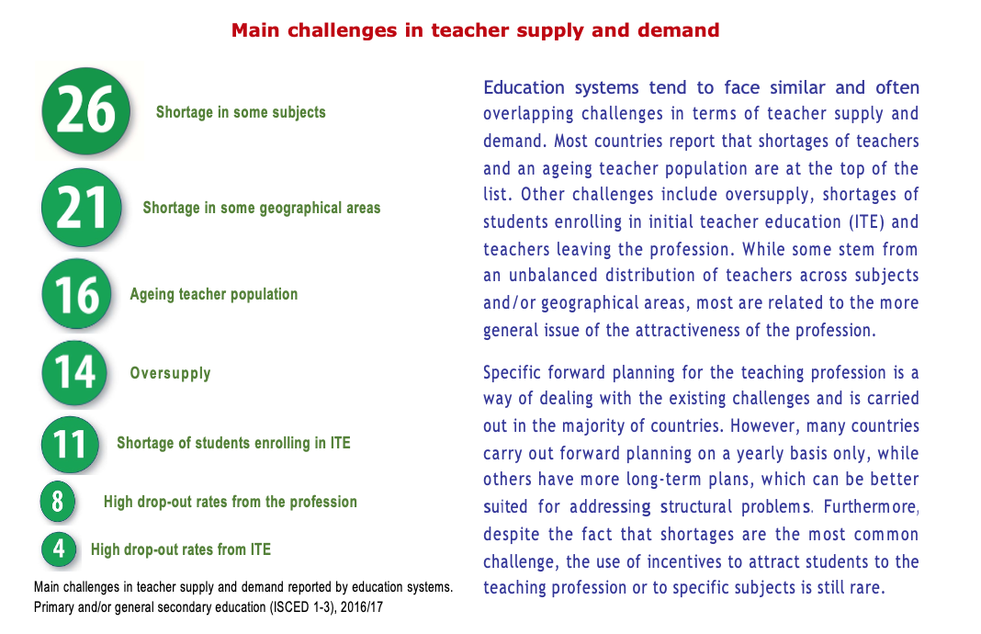
III. Main problems of the teaching function in Europe.

Slide 6
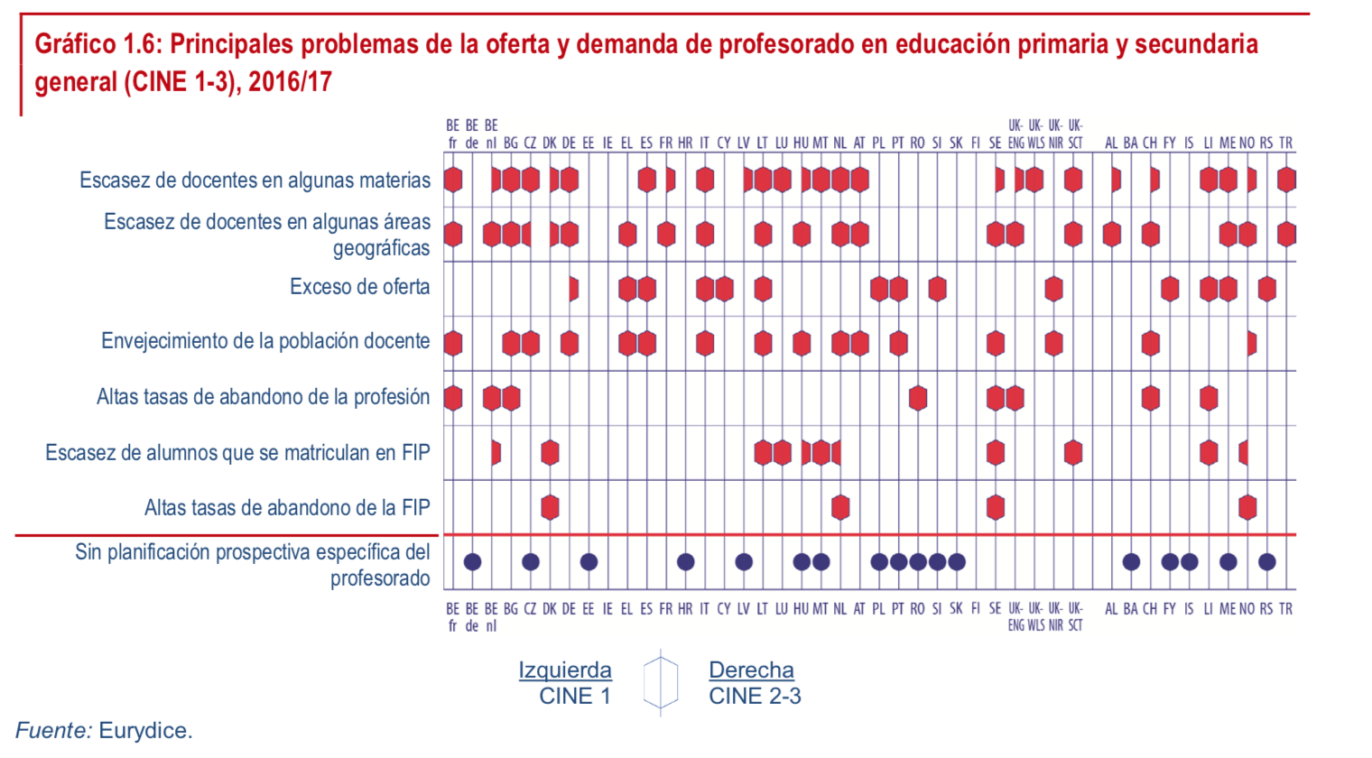
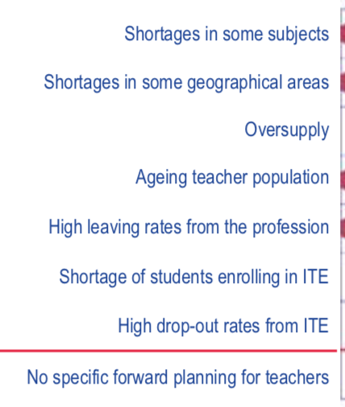
III. Main problems of the teaching function in Europe.

Slide 7
III.1. Professional induction programs (PIP) in Europe
Professional immersion phase (initiation-admission-mentoring-tutoring): is the structured support phase that is offered, either to teachers who have just entered the profession, or to future teachers. Teachers carry out all or part of the tasks that correspond to experienced teachers and receive remuneration for their work.
Initiation has important formative and support components: additional training, one-on-one help and advice.
School directors play an important role in supporting new teachers, organizes regular meetings to discuss progress made and existing personal and professional problems and provide input and offer advice.
European Commission / EACEA / Eurydice, 2018. The teaching profession in Europe: Access, progression and support.
Eurydice report. Luxembourg: Publications Office of the European Union.

Slide 8
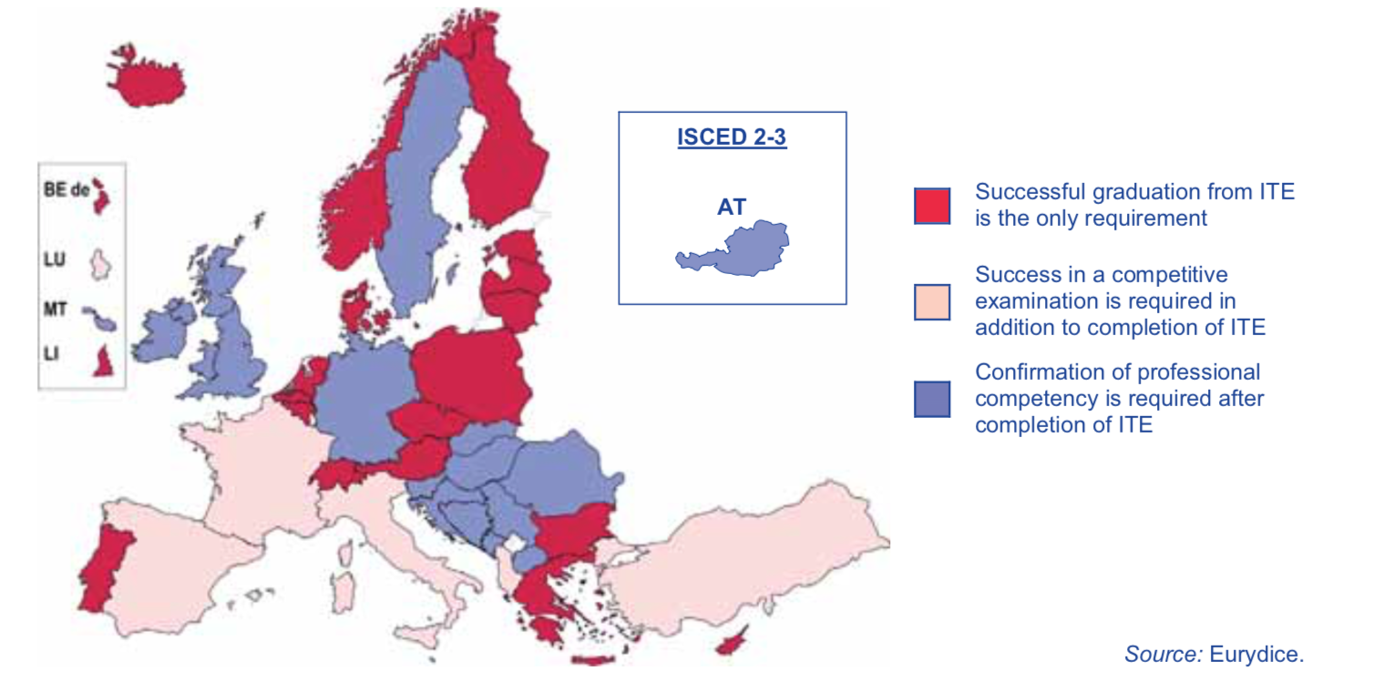
III.1. Professional induction programs (PIP) in Europe
Analyzes 32 educational systems. Includes all European Union countries, as well as Albania, Bosnia and Herzegovina, the former Yugoslav Republic of Macedonia, Switzerland, Iceland, Liechtenstein, Montenegro, Norway, Serbia and Turkey.

Slide 9
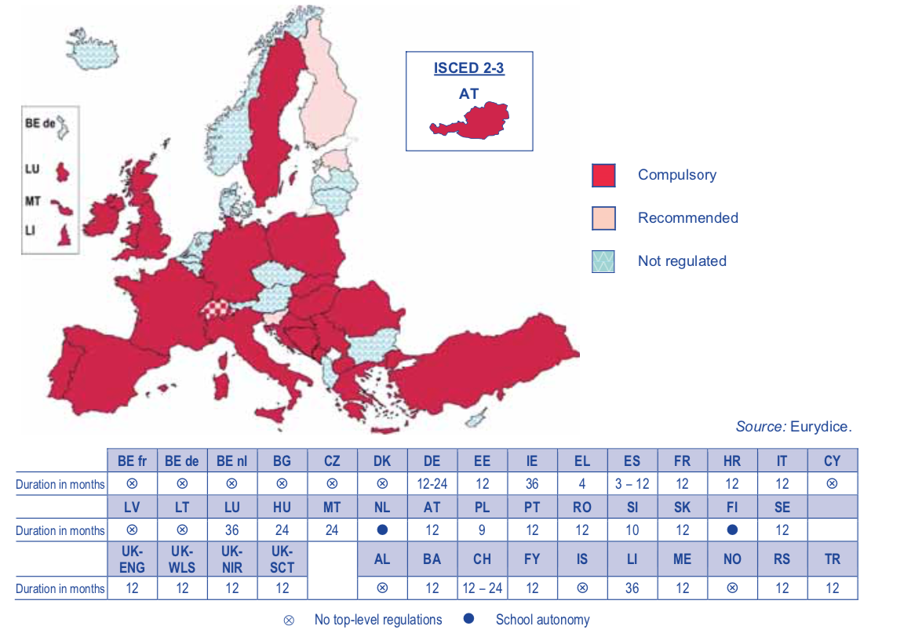
III.1. Professional induction programs (PIP) in Europe (CINE 1-3).
Notes:
5. Duración programas iniciación În 26 de sisteme, o fază de admisie structurată este obligatorie prin reglementările autorității de cel mai înalt nivel

Slide 10
III.1. Professional induction programs: Aims
For Serpell, 2000; European Trade Union Committee for Education, 2008; OECD, 2005; The objectives are:
Socialize beginners
Resolve your concerns by ensuring your professional development
Increase retention of beginning teachers.
improve the quality of teachers
Horn, Sterling and Subhan (2002), consider that for a teaching initiation program to be successful, it must achieve the following objectives:
• Guide before the beginning of the course so that novice teachers get to know the school.
• Have the presence of a Mentor to advise and help the beginning teacher.
• Adjust working conditions, offer them materials or resources to help them in their teaching work.
• Reduce work time at school so that they can carry out training activities
• Encourage collaboration with co-workers so that you do not feel isolated.
• Assess the work done by novice teachers to detect their strengths and weaknesses

Slide 11
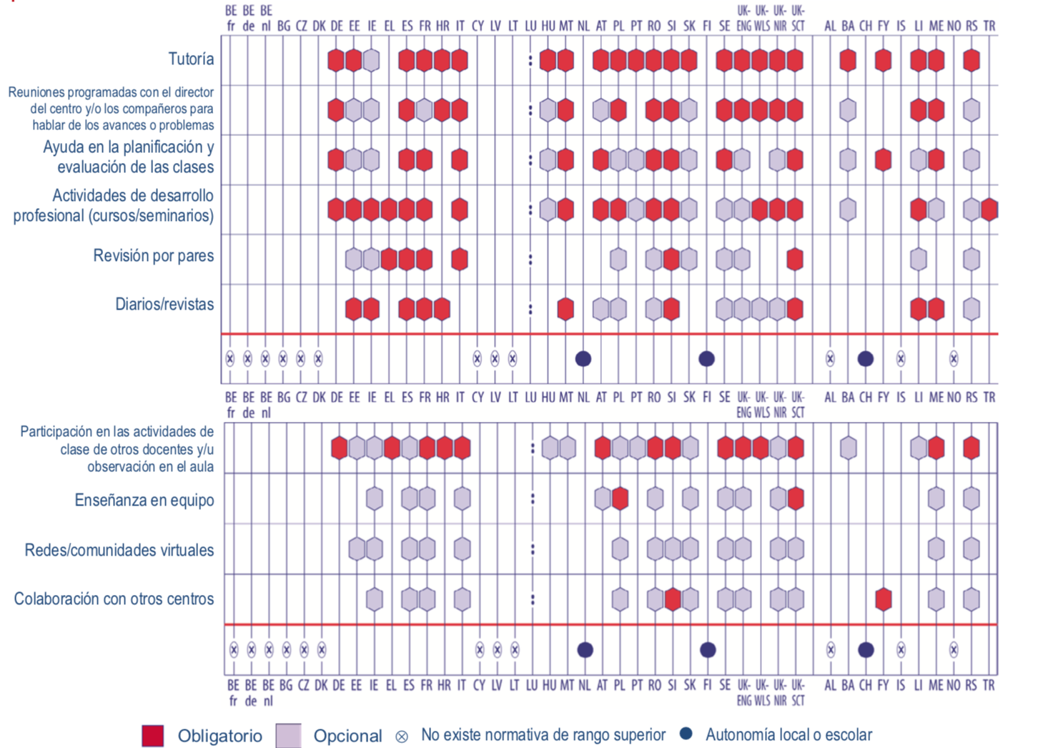
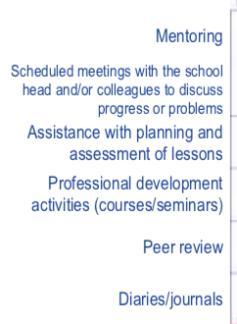
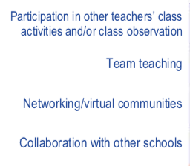
III.1. Professional induction programs: Main support activities

Slide 12
III.2. Results of research on the problems of
beginning teachers analyzed from the European model of
Professional Teacher Competencies.
Veenman (1984) synthesised 83 studies carried out in the United States, Great Britain and Wales, the Netherlands, Canada, West Germany, and Australia on beginning teachers at primary and secondary level; Voss and Kunter, 2020; Manso and Garrido, 2021; Schaefer et al. 2021; Cruz et al. 2022 and Napolitano et al., 2022)
PROFESSIONAL COMPETENCES EUROPEAN MODEL |  | Identified needs of novice teachers
To know: | Scientific competence. | Master the content of the different subjects he/she must teach. Selecting the content to be taught
Know how to be: | Intrapersonal and interpersonal competence. | Lack of personal free time Insecurity and need for emotional support.

Slide 13
III.2. Results of research on the problems of
beginning teachers analyzed from the European model of
Professional Teacher Competencies.
PROFESSIONAL COMPETENCES EUROPEAN MODEL |  | Identified needs of novice teachers
Know how to do what: | Didactic competence | Knowing the causes that make learning easier or more difficult for students. Adapt the contents of the subjects to the conditions of the class and of each individual pupil. Determining the learning level of the pupils Adapt teaching to individual differences. Select appropriate materials for the development of the subject matter. Identifying the educational needs of learners. How to teach pupils of diverse cultural backgrounds and abilities. Encouraging pupils' participation in classroom activities.
 | Organizational and management competence | Coping with work overload. Getting involved in decision-making at school level. Managing time to prepare lessons. Carrying out bureaucratic work
 | Competency in coexistence management. | Maintaining order/discipline in the classroom. Dealing with problems with individual pupils. Promoting a positive learning environment.

Slide 14
III.2. Results of research on the problems of
beginning teachers analyzed from the European model of Professional Teacher Competencies.
PROFESSIONAL COMPETENCES OF EUROPEAN MODEL |  | Identified needs of novice teachers
Know how to: | Teamwork competence | No references found
 | Competence in innovation and improvement | Mastering different active teaching methods Use different ways of assessing learners.
 | Communicative and linguistic competen. | No references found
 | Digital competence (ICT). | Using information and communication technologies in the classroom
Know to be: | Social-relational competence | Motivating learners in class. Treating pupils in a differentiated and individualized way. Knowing pupils' satisfaction with teaching. Create an appropriate atmosphere through respectful relationships with students. To relate to the other teachers in the school. Liaising with the management team. Liaising with parents

Slide 15
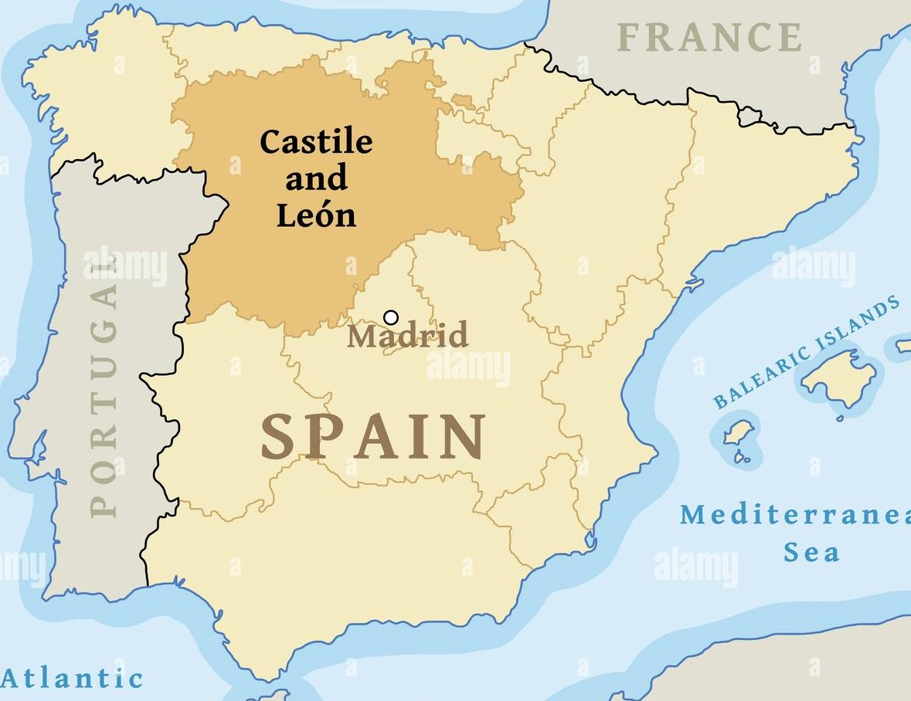
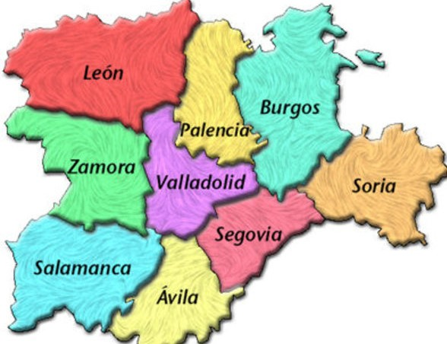
VI. CASE STUDY EDUCATIONAL AND PSYCHOPEDAGOGICAL GUIDANCE and COUNSELING TEAM (EOEP LEÓN2)

Slide 16
IV.1. Contextualisation CASTILE AND LEON DEPARTAMENT OF EDUCATION Legal Regulations: Decreto 5/2018, Educational, Vocational and Professional Guidance Model
E.O.E.P. León 2
EDUCATIONAL AND PSYCHOPEDAGOGICAL GUIDANCE and COUNSELING TEAM
Departamento de Orientación D.O.
GUIDANCE DEPARTMENT
EXTERNAL SERVICE
EDUCATIONAL LEVELS
Early Childhood Education (3 – 6)
Primary education (6 – 12)
INTERNAL SERVICE AT THE CENTER
EDUCATIONAL LEVELS
Secondary Education
12- 16 - Compulsory Secondary School
16 -18 – Non Compulsory Secondary School
IMPLIES DIFFERENCES IN THE MENTORING

Slide 17
IV.1. Contextualisation: DIFFERENCES IN THE MENTORING
E.O.E.P. León 2
EDUCATIONAL AND PSYCHOPEDAGOGICAL GUIDANCE and COUNSELING TEAM
Departamento de Orientación D.O.
GUIDANCE DEPARTMENT
Type of Professionals
educational counselors (1)
teachers community services (1)
other teachers (scientific, linguistic, technical, support áreas)
Tutoring by a teacher from another specialty
Type of Professionals
educational counselors (11)
teachers community services (4)
Weekly coordination
More common issues

Slide 18
IV.1. Contextualisation: FUNCTIONS OF THE GUIDANCE TEACHER Primary school greater emphasis on education Secondary school to include vocational and professional attention It requires: Knowledge and actions of a complex and specific nature to help educational centers offer a personalized and quality education to achieve the integral development of all students. An ambitious goal that implies knowing: What to do? different tasks depending on the time of the course). PLANNING How to do? to know and handle techniques and instruments.

Slide 19
THEORETICAL KNOWLEDGE
GOOD PRACTICES
MAKING DECISIONS ABOUT PEOPLE IN THEIR INFANCY
POSITIVE OR NEGATIVE IMPACTS

Slide 20
AREAS OF ACTION ICT
CENTER AND TEACHING STAFF
Advise and collaborate on:
Plans, Programs
Organisational Measures
Activities
Documents
STUDENTS
Counseling on diversity measures:
ORDINARY
EXTRAORDINARY
Psychopedagogical evaluation
FAMILIES
FAMILY-SCHOOL COLLABORATION
FAMILIES OF SPECIFIC STUDENTS
DIFFUSION GROUPS
OTHER INSTITUTIONS THAT WORK WITH CHILDREN
HEALTH SERVICES
SOCIAL SERVICES
LEGAL SERVICES
PRIVATE OFFICES

Slide 21
IV.2. SWOT ANALYSIS NOVICE – BEGINNING TEACHERS
STRENGTHS
Theoretical, scientific and regulatory knowledge
ICT skills
Intermediate - high English level
WEAKNESSES
Lack of knowledge of practical elements
Planning difficulties (Urgent vs important)
Insecurity, high stress level
OPPORTUNITIES
Mentoring teacher
Colleagues in the same specialty
Weekly meetings
Material resources of the team
Equitable sharing of work
THREATS
Demand of functions/ tasks by the schools (excess)
Professional consideration, inexperienced image in schools

Slide 22
IV.2. SWOT ANALYSIS TUTORING TEACHERS
STRENGTHS
Previous professional experience
Security and prestige gained
Personal satisfaction in helping
WEAKNESSES
Increase in work (Extra work)
OPPORTUNITIES
Professional development: “keep up to date”, good model
Updated topics and resources
THREATS
No compensation (professional, economic…)
No specific timetable is contemplated

Slide 23
V. CONCLUSIONS
Intern
Need to establish a global-systemic model that includes the different phases of professional development with clear indicators that identify the level of depth to acquire the key competences in each phase.
Influence issues of new roles and competencies in induction programs: ICT, languages, teaching-learning processes in contexts of diverse capacities and cultures, relations with the Educational Community.
Link training and research to analyze and learn skills in practical contexts. Strengthen bridges between researchers and practitioners with participatory and inclusive research models.
Strengthen the involvement of the School Management Team and the Mentor Teachers with greater professional / economic recognition for their task.
Need to establish a glossary with terms related to teacher professional training that respect cultural traditions but clarify the models and practices that they identify in order to carry out in-depth comparative studies
Teachers

Slide 24
V. Proposals for improvement:
Collaborative work of the tutor teachers: action protocols, material resources, etc. for these tasks.
Participation in institutional projects that increase the professional competence (Tutors and novice teachers)
Professional recognition for tutor teachers (professional, economic, time…)
Topics for further investigation:
Improve the system for evaluating the impact/repercussion of training on teaching practices.
How to evaluate mentoring roles? and How do you select the “Best Mentors” objectively?.
How to improve career development opportunities in rural areas

